Slide 1
Regular Expressions

Slide 2
Problem
Write a Python code to check if the given mobile number is valid or not. The conditions to be satisfied for a mobile number are:
a) Number of characters must be 10
b) All characters must be digits and must not begin with a ‘0’

Slide 3
Validity of Mobile Number
Input | Processing | Output
A string representing a mobile number | Take character by character and check if it valid | Print valid or invalid

Slide 4
Test Case 1
abc8967891
Invalid
Alphabets are not allowed

Slide 5
Test Case 2
440446845
Invalid
Only 9 digits

Slide 6
Test Case 3
0440446845
Invalid
Should not begin with a zero

Slide 7
Test Case 4
8440446845
Valid
All conditions statisfied

Slide 8
Python code to check validity of mobile number (Long Code)
import sys
number = input()
if len(number)!=10:
print ('invalid')
sys.exit(0)
if number[0]==‘0’:
print ('invalid')
sys.exit(0)
for chr in number:
if chr.isalpha():
print ('invalid')
break
else:
print('Valid‘)

Slide 9
Manipulating text or data is a big thing
If I were running an e-mail archiving company, and you, as one of my customers, requested all of the e-mail that you sent and received last February, for example, it would be nice if I could set a computer program to collect and forward that information to you, rather than having a human being read through your e-mail and process your request manually.

Slide 10
Another example request might be to look for a subject line like “Winner,” indicating a virus-infected message, and remove those e-mail messages from your personal archive.
So this demands the question of how we can program machines with the ability to look for patterns in text.
Regular expressions provide such an infrastructure for advanced text pattern matching and/or search-and-replace functionality.
Python supports regexes through the standard library re module

Slide 11
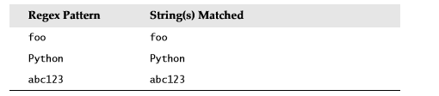
regexes are strings containing text and special characters that describe a pattern with which to recognize multiple strings.
Regexs without special characters
These are simple expressions that match a single string
Power of regular expressions comes in when special characters are used to define character sets, subgroup matching, and pattern repetition

Slide 12
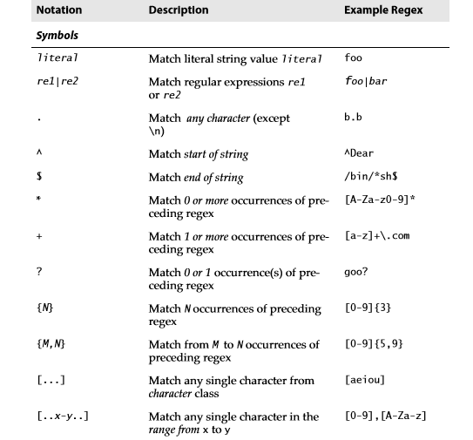
Special Symbols and Characters

Slide 13

Special Symbols and Characters

Slide 14
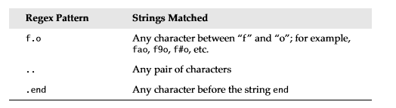
Matching Any Single Character (.)
dot or period (.) symbol (letter, number, whitespace (not including “\n”), printable, non-printable, or a symbol) matches any single character except for \n.
To specify a dot character explicitly, you must escape its functionality with a backslash, as in “\.”

Slide 15
import re
if re.match("f.o","fooo"):
print("Matched")
else:
print("Not matched")
Output:
Prints matched
Since it searches only for the pattern ‘f.o’ in the string

Slide 16
import re
if re.match("f.o$","fooo"):
print("Matched")
else:
print("Not matched")
Check that the entire string starts with ‘f’, ends with ‘o’ and contain one letter in between

Slide 17
import re
if re.match("..","fooo"):
print("Matched")
else:
print("Not matched")
Matched
Two dots matches any pair of characters.

Slide 18
import re
if re.match("..$","fooo"):
print("Matched")
else:
print("Not matched")
Not matched
Including a ‘$’ at the end will match only strings of length 2

Slide 19
import re
if re.match(".end","bend"):
print("Matched")
else:
print("Not matched")
Matched
The expression used in the example, matches any character for ‘.’

Slide 20
import re
if re.match(".end","bends"):
print("Matched")
else:
print("Not matched")
Prints Matched
import re
if re.match(".end$","bends"):
print("Matched")
else:
print("Not matched“)
Prints Not matched - $ check for end of string

Slide 21
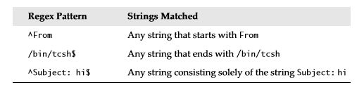
Matching from the Beginning or End of Strings or Word Boundaries (^, $)
^ - Match beginning of string
$ - Match End of string
if you wanted to match any string that ended with a dollar sign, one possible regex solution would be the pattern .*\$$

Slide 22
But not sufficient
Check whether the given register number of a VIT student is valid or not.
Example register number – 15bec1032
Register number is valid if it has two digits
Followed by three letters
Followed by four digits

Slide 23
Denoting Ranges (-) and Negation (^)
brackets also support ranges of characters
A hyphen between a pair of symbols enclosed in brackets is used to indicate a range of characters;
For example A–Z, a–z, or 0–9 for uppercase letters, lowercase letters, and numeric digits, respectively

Slide 24
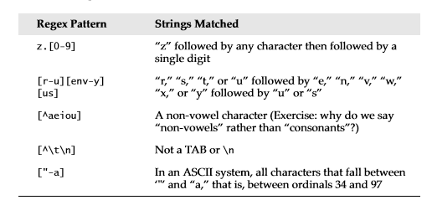

Slide 25
Multiple Occurrence/Repetition Using Closure Operators (*, +, ?, {})
special symbols *, +, and ?, all of which can be used to match single, multiple, or no occurrences of string patterns
Asterisk or star operator (*) - match zero or more occurrences of the regex immediately to its left
Plus operator (+) - Match one or more occurrences of a regex
Question mark operator (?) - match exactly 0 or 1 occurrences of a regex.

Slide 26
There are also brace operators ({}) with either a single value or a comma-separated pair of values. These indicate a match of exactly N occurrences (for {N}) or a range of occurrences; for example, {M, N} will match from M to N occurrences

Slide 27
Code to check the validity of register number
import re
register= input()
if re.match("^[1-9][0-9][a-zA-Z][a-zA-Z][a-zA-Z][0-9][0-9][0-9][0-9]$",register):
print("Matched")
else:
print("Not matched“)
^ - denote begin (Meaning is different when we put this symbol inside the square bracket)
$ - denote end

Slide 28
[dn]ot?
o?[1-9]
[0-9]{15,16}

Slide 29
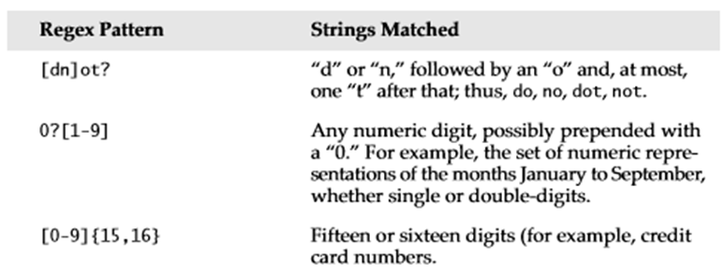

Slide 30
Refined Code to check the validity of register number
{n} – indicate that the pattern before the braces should occur n times
import re
register= input()
if re.match("^[1-9][0-9][a-zA-Z]{3}[0-9]{4}$",register):
print("Matched")
else:
print("Not matched")

Slide 31
Check validity of Mobile Number (Shorter Code)
import re
number = input()
if re.match(‘[^0][0-9]{9}',number):
print('valid')
else:
print('invalid')
Bug: Will also accept a843338320

Slide 32
Check validity of Mobile Number (Shorter Code)
import re
number = input()
if re.match(‘[1-9][0-9]{9}',number):
print('valid')
else:
print('invalid')

Slide 33
Python reads all input as string
In some cases it is necessary to check if the value entered is an integer
We can check it using regular expressions
Rules for an integer
optionally begin with a negative sign include ^ symbol
first digit must be a number other than zero
may be followed zero to any number of digits
string must end with it so add $ symbol

Slide 34
import re
register= input()
#optionally begin with a negative sign include ^ symol
#first digit must be a number other than zero
# may be followed zero to any number of digits
# string must end with it so add $ symbol
if re.match("^\-?[1-9][0-9]*$",register):
#'\' is added in front of '-' to overcome its default meaning in REs
print("Matched")
else:
print("Not matched")

Slide 35
Rules for an integer or a floating point value
optionally begin with a negative sign include ^ symbol
first digit must be a number other than zero
may be followed zero to any number of digits
string must end with it so add $ symbol
Optionally followed by a ‘.’
Followed by zero or more digits
String ends here

Slide 36
import re
register= input()
if re.match("^\-?[1-9][0-9]*\.?[0-9]*$",register):
# ’.’ can occur zero or one time followed by a digit occurred zero to infinite number of times
print("Matched")
else:
print("Not matched")

Slide 37
Check for validity of email address
Check for validity of date

Slide 38
Search for occurrence of a pattern
m=re. search(regex,string)
Eg: To search for name and age in a string
regex=“([A-Z][a-z]+).*(([0][1-9]|[1-9][0-9]|[1][0-9]{2})”
m=re.search(regex,”my name is Sandra and my age is 20”)
m.start()
>>>11

Slide 39
m.group(0)
>>>Sandra and my age is 20
m.group(1)
>>>Sandra
m.group(2)
>>>”20”

